Slide 1
Health
Chapter 1

Slide 2
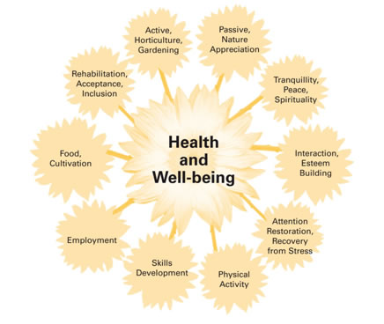
What is Health?
The well-being of your body, your mind, and your relationships with other people

Slide 3
3 Aspects
It’s as easy as P.M.S.
Physical-Body
Mental-Mind
Social-Relationships
All considered equal!!

Slide 4
Illness/Wellness Continuum
A model that shows the extremes of wellness & illness
Want to be somewhere in the middle or closer to the wellness end

Slide 5
Chapter 1 Lesson 2
Identifying Health Risks

Slide 6
What is a Risk Factor?
Any action or condition that increases the likelihood of injury, disease, or negative outcome.
What are some risk factors in lives of teens?

Slide 7
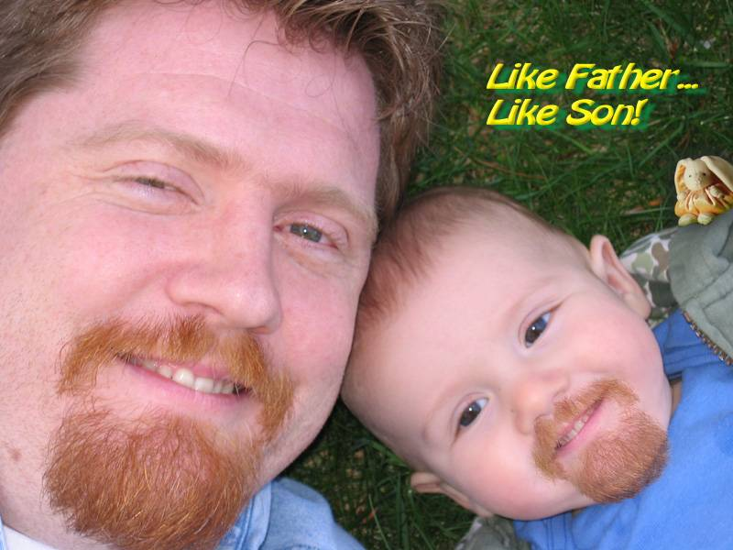
Risk Factors
Heredity
All traits passed biologically from parent to child
Cancer
Heart Disease
Alcoholism

Slide 8
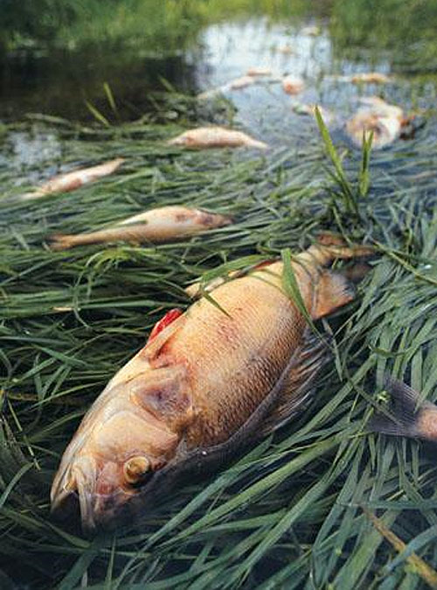
Risk Factors
Environmental
Physical: Outdoor/Indoor
Social: People around you
Culture: Shared by a group for generations

Slide 9
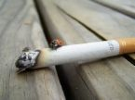
Risk Factors
Behavioral
Your actions & decisions
You decide what to face
Immediate
Long term

Slide 10
Risk Factors
Which risk factor has the biggest influence on teen Health?
WHY???

Slide 11
Risk Factors
What are your biggest Risk Factors in your own personal life?
Examples….

Slide 12
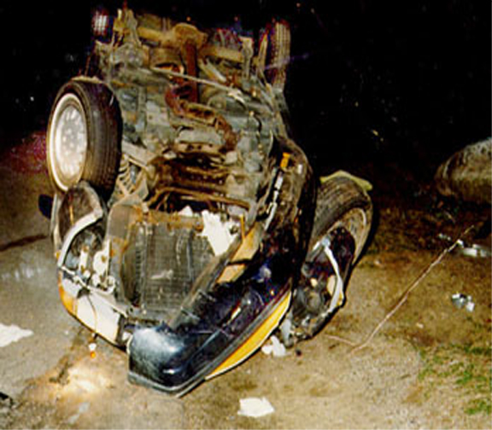
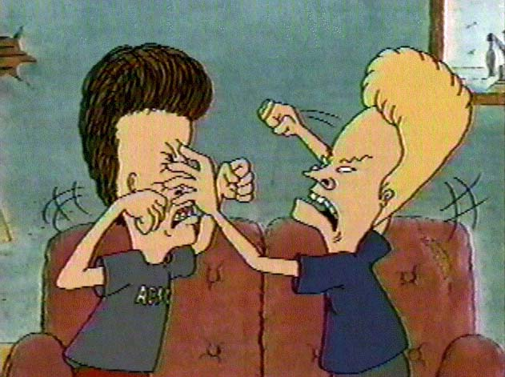
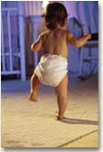
Risk Factors

Slide 13
Risk Factors
Should you take RISKS in life???
How do you DECIDE???
HEALTH…it’s up to YOU!!!

Slide 14
4 Steps to Change Health
Awareness
Recognize the problem
Knowledge
Learn…education
Decision-Making
What to do?!?
Applying Skills
Using what you learned

Slide 15
Cumulative Risks
Risks that build up over time.
Examples
Smoking
Drinking
Unhealthy eating
Can also combine risks which will increase your likelihood of becoming hurt, sick, dead, etc.
Example- Texting & driving without a seatbelt on.

Slide 16
Protective Factors
Factors present in a teen’s life that help the amount of risk taking behaviors & the chances for growing up as a healthy, caring, & responsible adult.
Examples
Parents, friends, values, etc.

Slide 17
Abstinence
Voluntarily choosing not to do something
Not just sexual activity, includes all high risk behaviors
One of most important health behaviors you can make as a teen

